Slide 1
Simon Says - Embedded Systems Game
STEM Bridges 2025-2026

Slide 2
What is Simon Says?
Single-player game
LEDs turn on in a specific order and you have to replicate the order
Get them all right and you win?
Miss an LED? Start over from the beginning!
Requires a microcontroller unit (MCU), some LEDs, some resistors, and some buttons!
Relatively easy to make

Slide 3
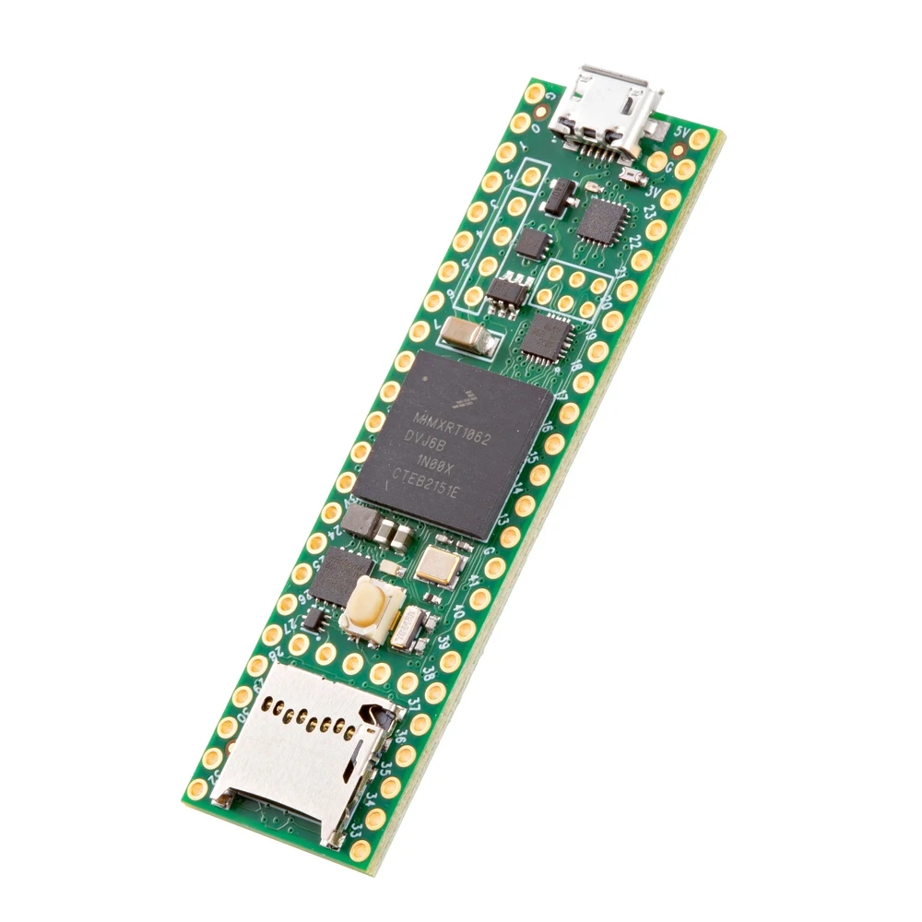
What is a MCU?
An MCU is a microcontroller unit
Essentially a small computer
Configure everything!
For this , we will use C code and manually mess with the microcontroller to have it turn on lights
Starts off very complex but becomes simple when understanding the game!
Everything can be turned ‘on’ or ‘off’, and we configure addresses in memory (specific bits inside the MCU) that can turn on specific things we want
Teensy 4.1
The microcontroller we are using

Slide 4
How Exactly does this Game Work?
Configure MCU to turn on specific output pins (GPIO - General Purpose Input/Output) - these turn on the LEDs
The MCU turns on one LED then pauses (ex: LED 2)
  Here we press the corresponding button to mimic the MCU (Simon)
If correct, the MCU restarts and moves on with the sequence (ex: LED 2, LED 1)
  If incorrect, start from the beginning, and a RED LED turns on
At the end of the sequence (say a 12-bit sequence), the MCU will flash a green LED to say you won!

Slide 5
The Inner Workings - In Code

Slide 6
C Code

Slide 7
The Build

